Slide 1
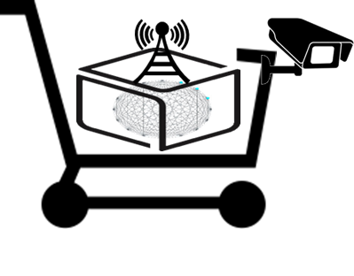



실시간 자세교정 프로그램
Date: Spring 2024 Place: Gwangju, Korea
[AIGS] Creative & Self-motivating Project
Team Code: I (20234075 – yewon.shin@gm.gist.ac.kr & Yewon Shin)
(20231181 – 20231181@gm.gist.ac.kr & Eunsol Park)
AI Graduate School, GIST

Slide 2
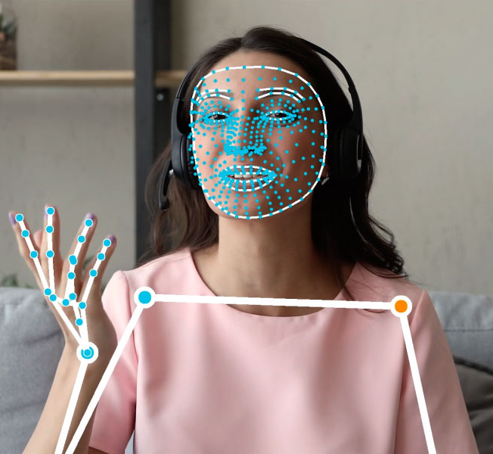

3C. Project Progress: Verification & Demo
Face & Pose detection/Tracking landmark settings

Slide 3
3C. Project Progress: Verification & Demo
Face & Pose detection/Tracking landmark settings

Slide 4
3C. Project Progress: Verification & Demo
Face & Pose detection/Tracking landmark settings
Forward neck posture
- B/A decreases
Uneven shoulder
- θ increases
Round shoulder
- C/A decreases
A
B
θ
C

Slide 5
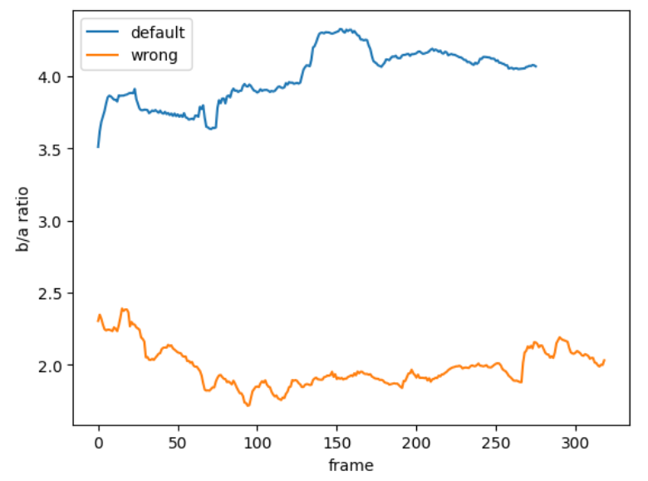
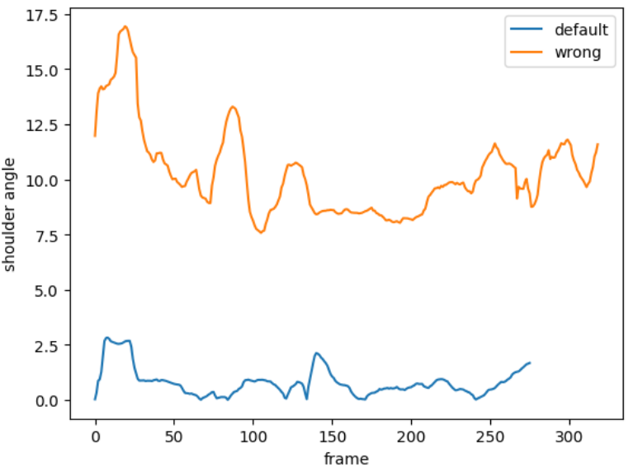
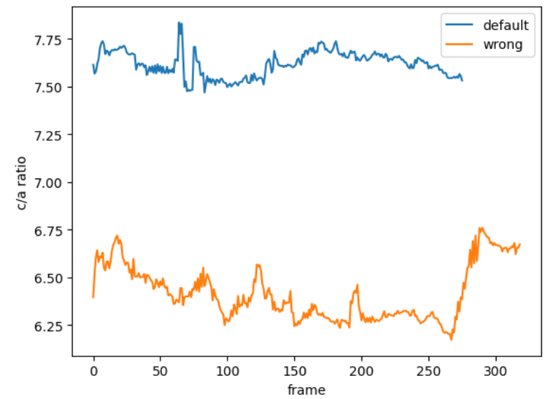
3C. Project Progress: Verification & Demo
Tracking records for recorded videos(4~5s)
바른 자세(default)와 잘못된 자세(wrong)일 때의 값 비교
Forward Head(B/A)
Uneven Shoulder(°)
Round Shoulder(C/A)

Slide 6
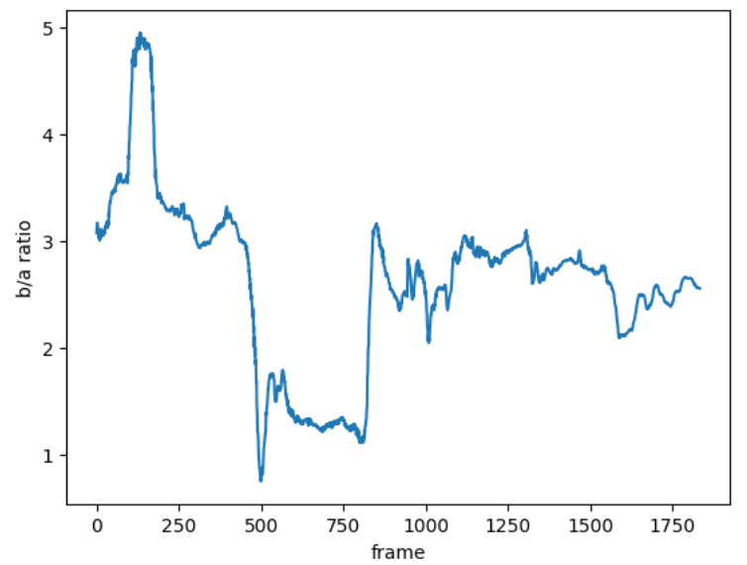
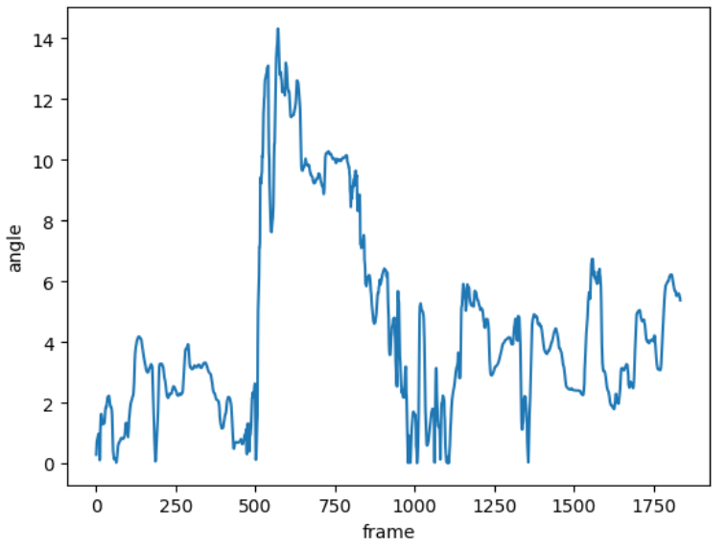
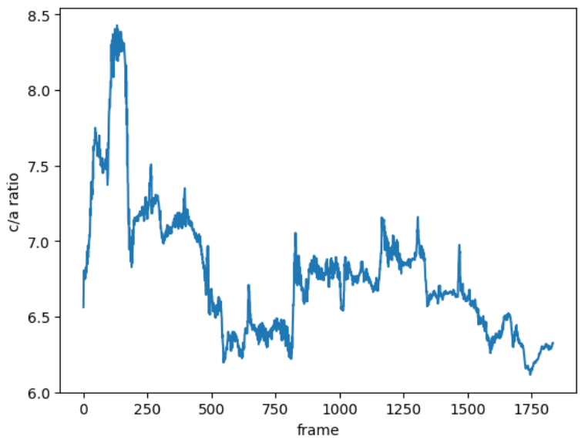
3C. Project Progress: Verification & Demo
Tracking records for recorded videos(1 min)
하나의 영상에서 자세를 바꿔가면서 촬영
Forward Head(B/A)
Uneven Shoulder(°)
Round Shoulder(C/A)

Slide 7
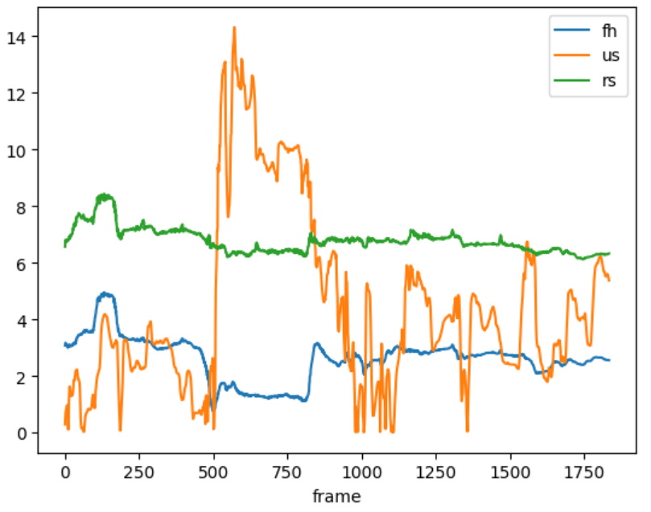
3C. Project Progress: Verification & Demo
Tracking records for recorded videos(1 min)
앞 슬라이드의 time series를 하나의 plot에 나타낸 결과

Slide 8
4A. Project Result: Overview
X+AI Service Realization with Representative Illustration …
Before & After

Slide 9
4A. Project Result: Outcomes
Project Outcomes #1, #2, …
Show main verification results for each outcome

Slide 10
4A. Project Result: Achieved Project Outcomes
(Recap) Scenarios for Demonstration / Evaluation
Outcome | Planned | Achieved | %
#1:
#2:

Slide 11
4B. Project Review: Self-check Details
Changed Items
Remaining Items and Future Plan

Slide 12
4B. Project Review: Ecosystem & Pointers
X+AI Ecosystem | Shared Infra. | Common SW Platforms | Data Sharing
Software Pointers | Developed | Recycled | Integrated
DataSets Pointers | Self-created | Open / Public | Enhanced from Open

Slide 13
4C. Project Service Demo: Files OR Video
Demo. Source Files | Software Folder / Files | DataSet Folder / Files | Demo Guide
Select ONE
Demo. Video | Software Snapshot | DataSet Snapshot | Demo Video

